Slide 1
Parametric t-SNE Gated Mixture of Sparse Experts (PT-MOE)

Slide 2
Abstract
A new SSL(Semi-Supervised Learning) technique which combines Parametric t-SNE to promote regional specialization in a collaborative Mixture of Experts(MoE) model.

Slide 3
Introduction
Increasing Layers and Data >> Prediction Accuracy
FCLs add noise complicates Training
With Increased Accuracy comes Increased Perplexity

Slide 4

Introduction
The difficulty in training deep neural networks begins and ends with the principle on which they are founded
FCL adds a quadratic increase in calculable parameters with increased nodes.
Problem
Models are too large.
Pt-SNE aims to fix this while improving accuracy.

Slide 5

Related Work
Dropout / DropConnect
Filtering and Pooling Layers in CNN
Pruning / Deep Compression
StochasticNet
Numerous Studies on Brain Structure

Slide 6
Sample References
Brain
”Anatomical funneling, sparse connectivity and redundancy reduction in the neural networks of the basal ganglia”
Sparse synaptic connectivity is required for decorrelation and pattern separation in feedforward networks.
“Scalable training of artificial neural networks with adaptive sparse connectivity inspired by network science” - Merged

Slide 7
Typical Fully Connected Layer
Inputs
Outputs

Slide 8

Typical Mixture of Experts

Slide 9
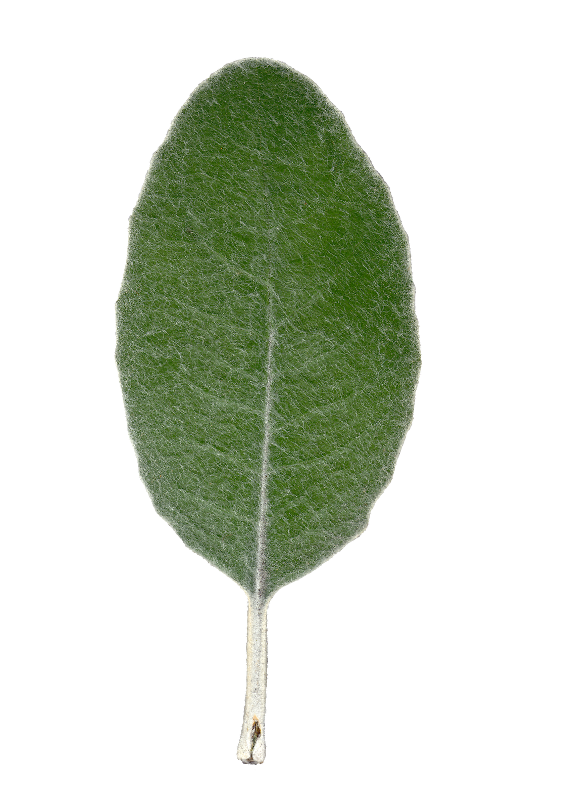
Gated Mixture of Experts

Slide 10
Sparse Layer

Slide 11
T-SNE
Compares MI Between Gaussians
Reduces to Euclidean Distance
Preserves the Structure

Slide 12
2D T-SNE
High Dimensional

Slide 13
Proposed Model
Pt-SNE

Slide 14
Goal
Model Local Clustering of Neurons
Maintain minimal but existing connections between neighboring clusters
Train Clusters to be Experts but shares knowledge

Slide 15
Contributions
Parametric T-SNE to Create a 2D Feature Map of Feature Space
2D Map to Gate the MoEs & Promote Regional Specialization
Sparsely Interconnected MoEs
Sparsely Intra-Connected MoEs

